Slide 1
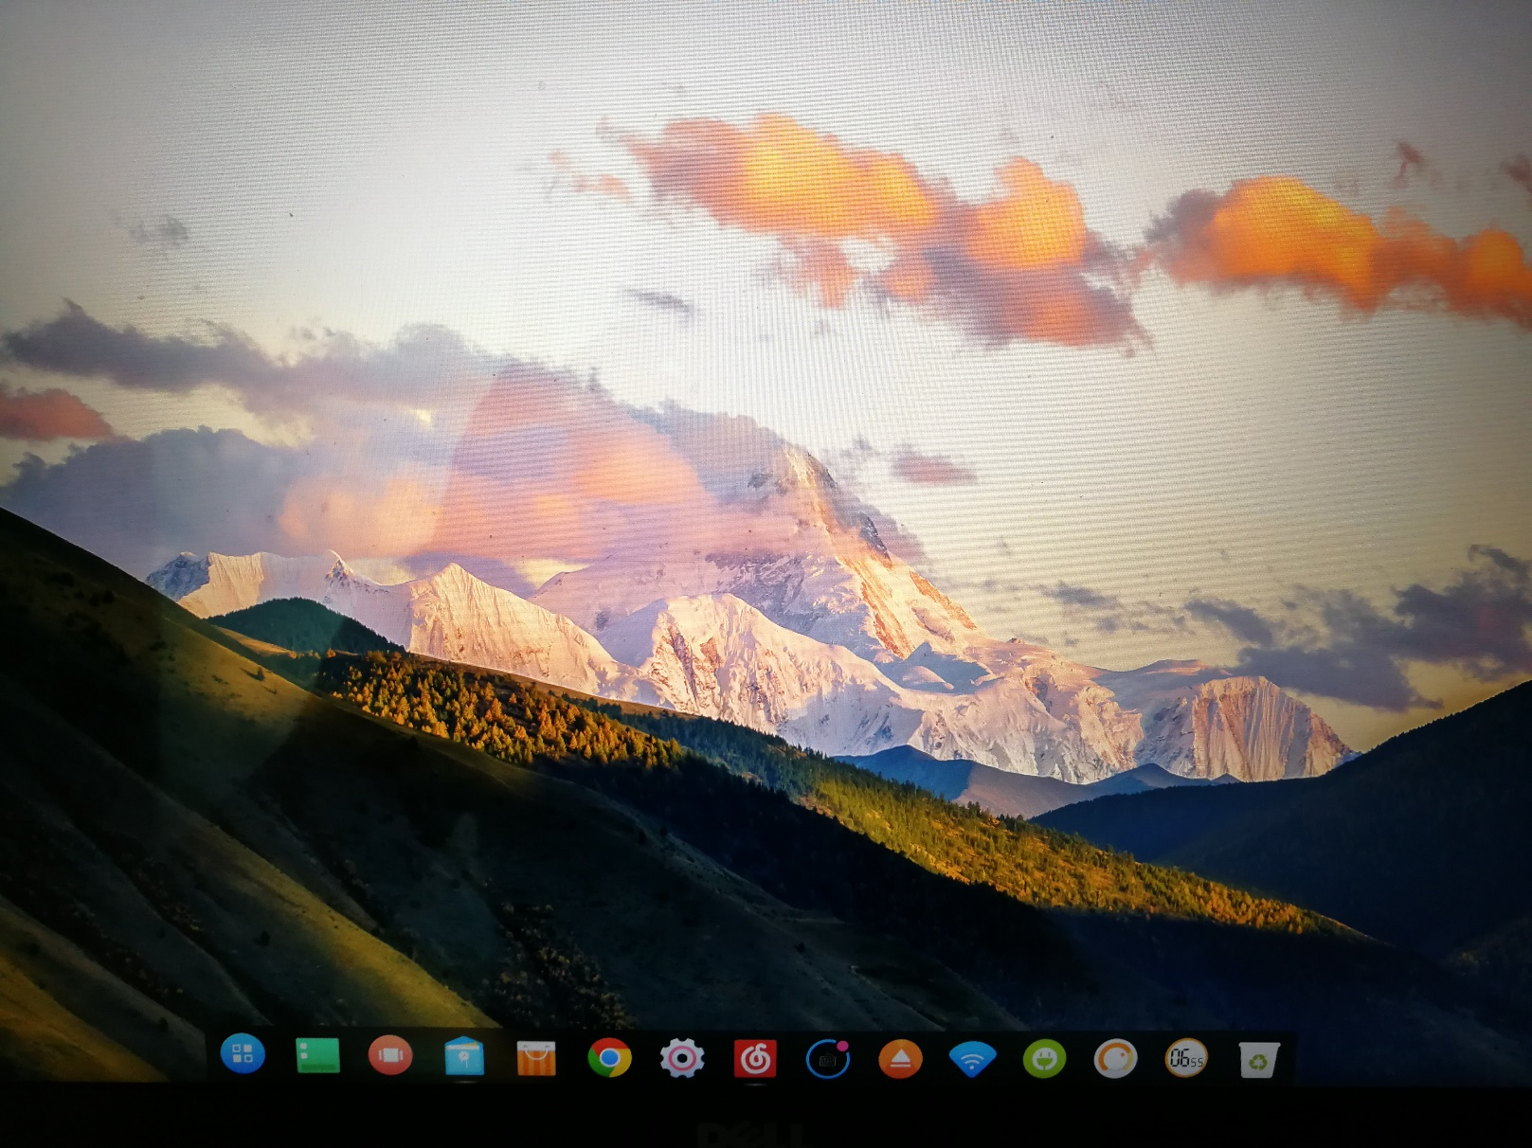
Operating Systems
Jinghui Zhong （钟竞辉）
Office：B3-515
Email ：jinghuizhong@scut.edu.cn

Slide 2
Session 1
【Objective and Requirement】
Objective： Be familiar with the creation of process and thread.
Requirement：
Task 1: Create a console application, “child”, which keeps printing out “The child is talking at [system time]” (in a loop, one per 1s).
Task 2: Create another console application, “parent”. It create a child process to execute “child”. At the same time, the “parent” process keeps printing out “The parent is talking at [system time]”. (one per 1s). Execute “parent” and explain the output you see.
Task 3: Create a child thread in the “mainThread” program. Both the main thread and the child thread keep printing out “[ThreadID] + [System time]”.
Task 4: Create a console application, which contains a shared integer shared_var. The initial value of shared_var is 0. The application will create a child thread after it starts. The main thread keeps increasing the value of shared_var by 1, while the child thread keeps decreasing the value of shared_var by 1. Explain the observed results.
【Environment】
Operating System：Linux;

Slide 3

Submission link
https://send2me.cn/Q-RFMmoh/R_SQ5k2lcCQ9vA

